Slide 1

FORECASTING FINANCIAL INSTRUMENTS PRICES
WITH VECM AND ARIMA MODELS
Presented by:
Nhan Nguyen
Shivam Varshney

Slide 2
Outline for presentation
Check for Cointegration
Apply Box-Jenkins Procedure
VECM Model and Analysis
Model Evaluation

Slide 3
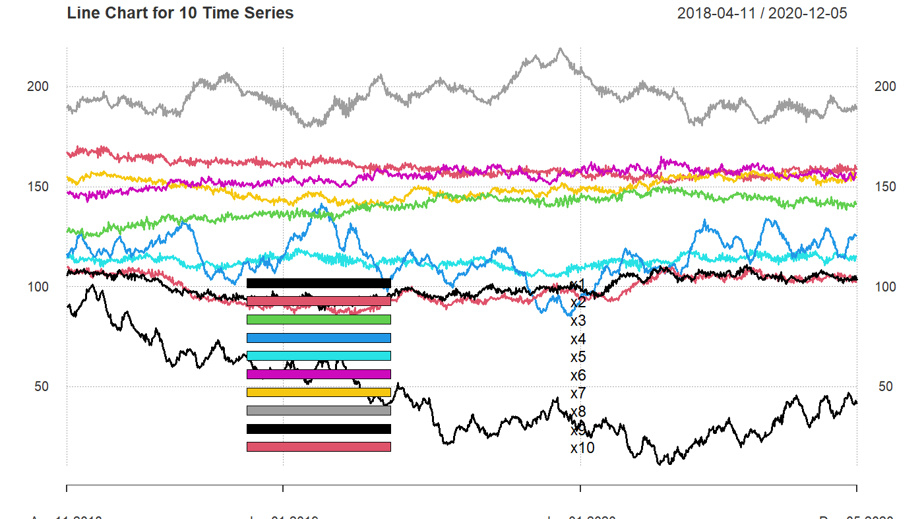
Checking for Cointegration

Slide 4
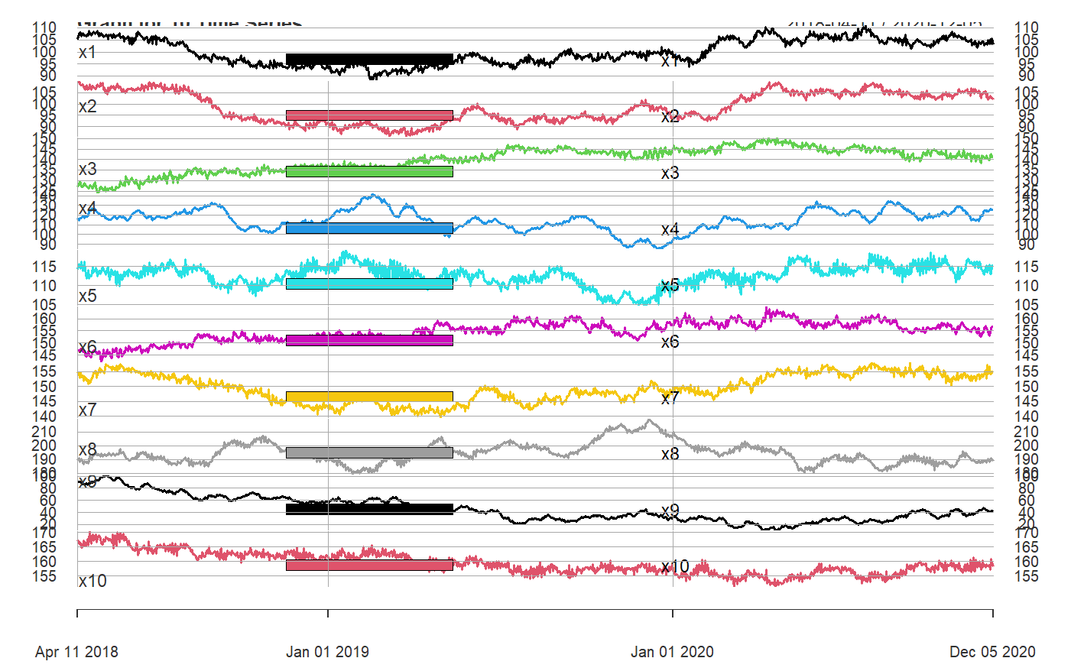
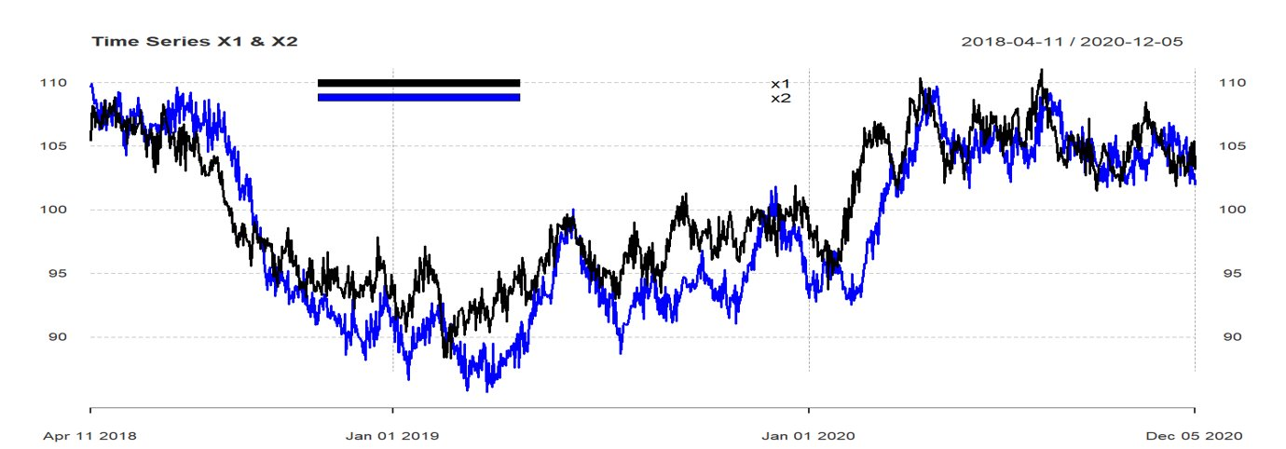
Data visualization
Based on the graph, we can see there is a long-term relationship between Time series X1 and X2. -> We decided to go for the first two time series and performed cointegration test.

Slide 5
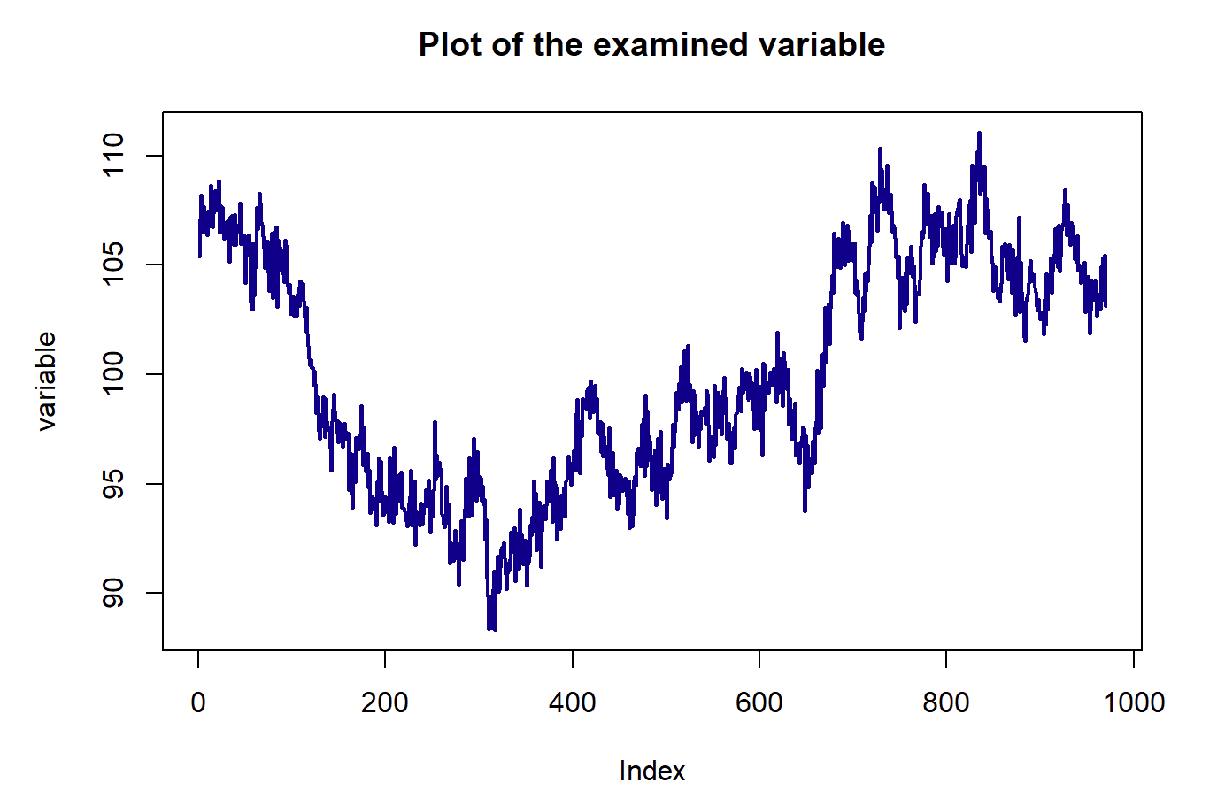
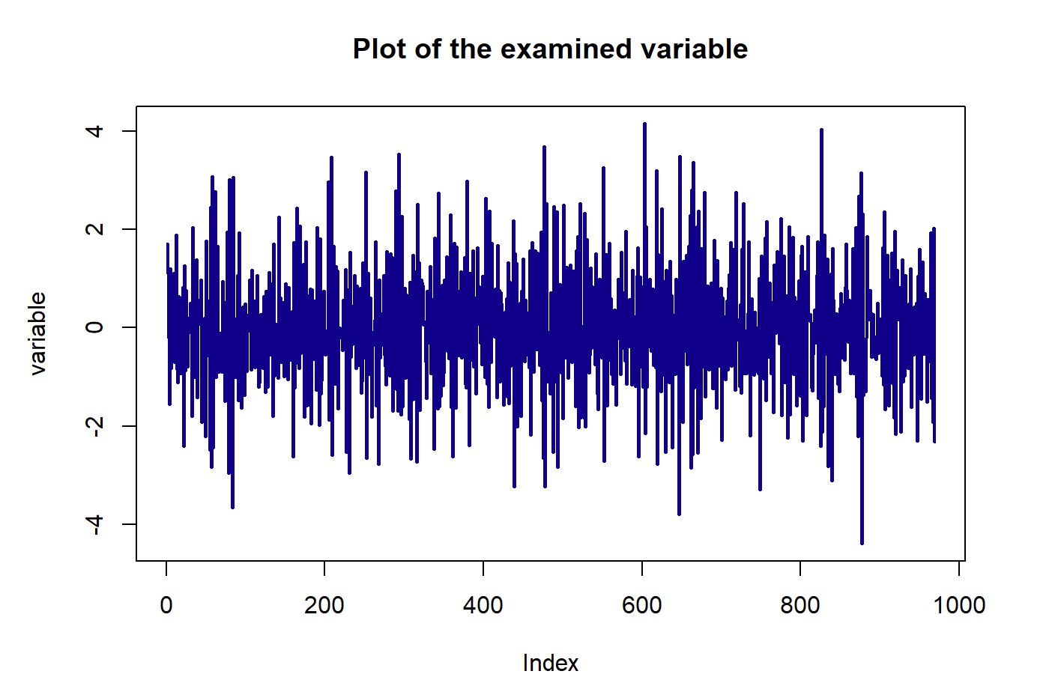
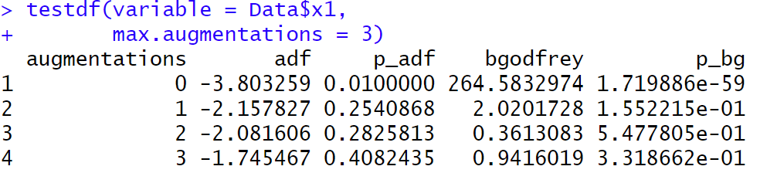
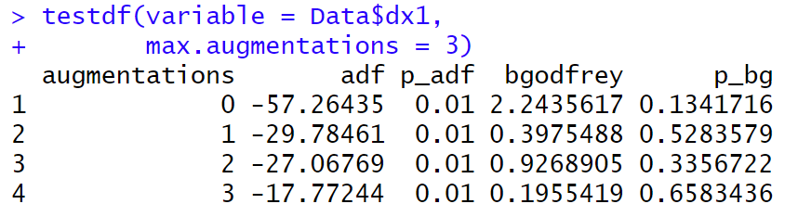
Apply ADF and BG Test on the original data and its 1st difference to test its stationarity
Testing for cointegration
-> Time Series X1 is integrated of order 1.
Notes:
Time series 1:
#The p-bg is greater than 5% -> there are no auto-correlations in residual
#Next, we test the stationary of its 1st lag, by checking p-adf.
#p-adf is smaller than 5%. We can reject the null in the case of the first differences about non-stationary.
#Its 1st lag is stationary.
#We can conclude that the Time Series X1 is integrated of order 1.
Time series 2:
#By adding 1 augmentation, there will be no auto correlation in Residuals.
#p-adf is greater than 5%, we can reject the null hypothesis in the case the non-stationary of first differences.
#Its 1st lag is stationary.
#we can conclude that the Time Series X2 is integrated of order 1.
#Conclusion:
#As a result, both variables has the same order 1: ∼I(1)
#so in the next step we can check whether they are cointegrated or not.

Slide 6
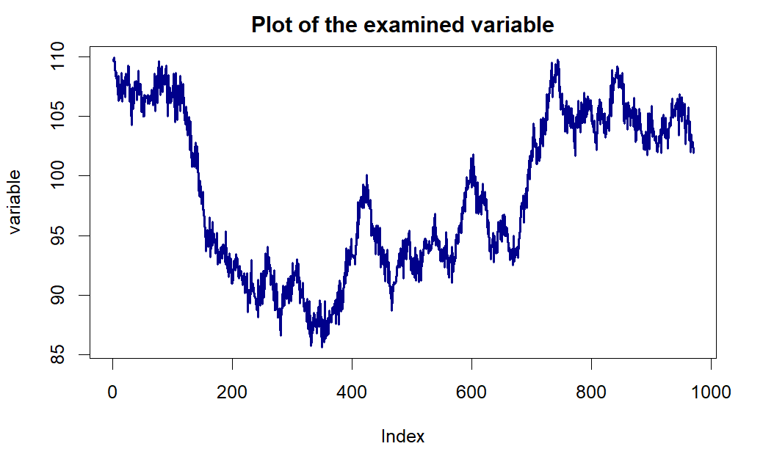
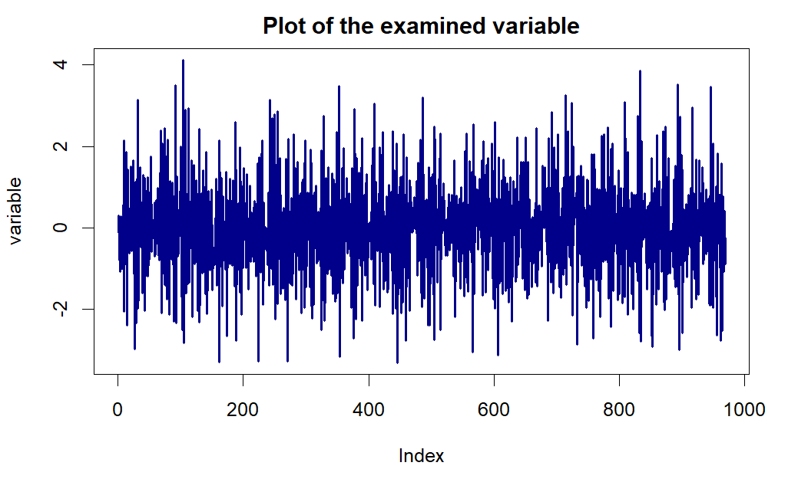
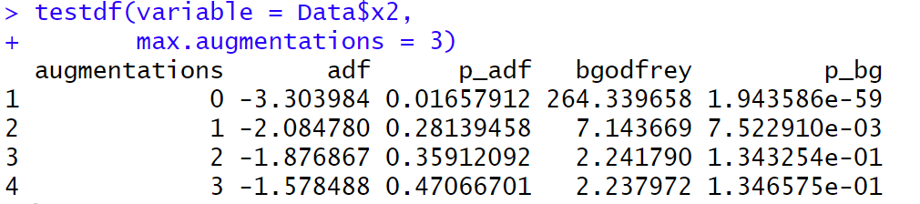
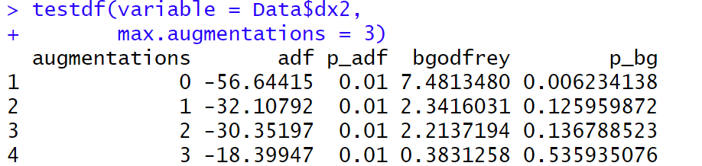
Time Series X2
-> Time Series X2 is integrated of order 1.

Slide 7
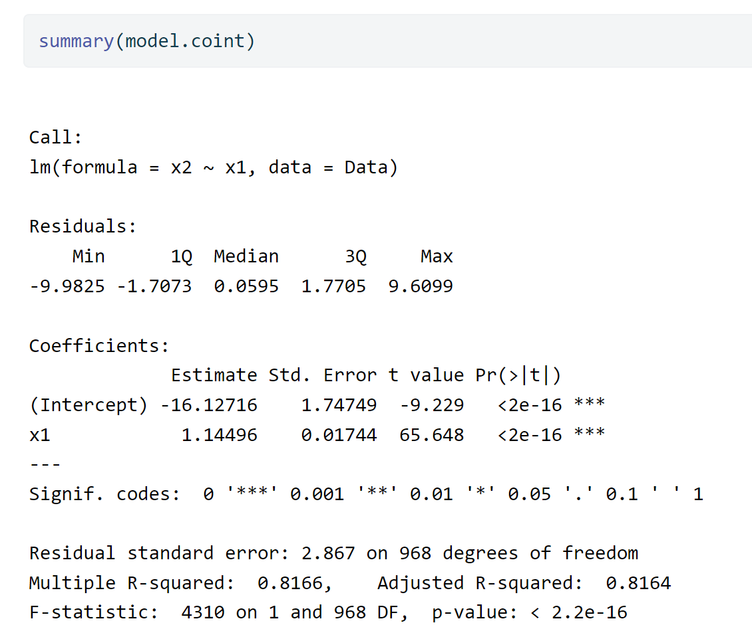
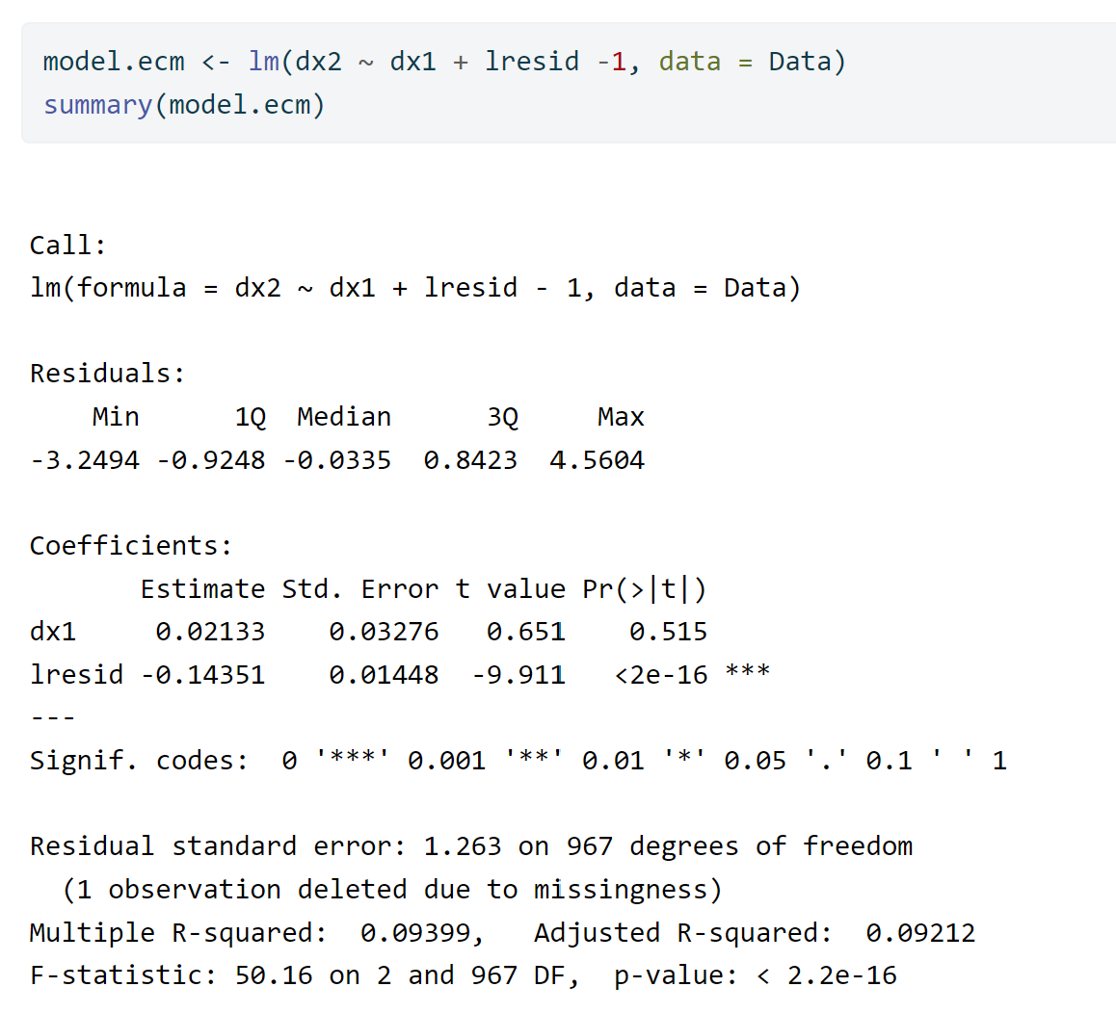
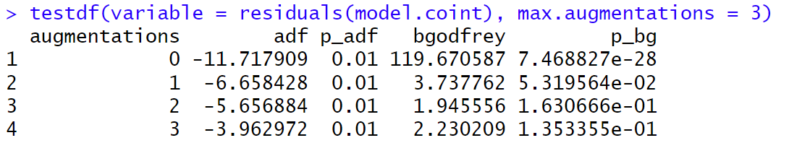
Estimating Cointegrated Vector
The cointegrating vector is [1, 16.127 , -1.145] -> relationship: 1 * x2 + 16.127 - 1.145* x1.
Residuals are stationary -> x1 and x2 are cointegrated.
Short term: 0.021 Long term: 1.145
Adjustment Coeff.: -0.144 -> 6.9 periods

Slide 8

Applying Box-Jenkins Procedure
Step 1: Identification
Model's order (using ACF and PACF)
Step 2: Model Estimation
for the coefficient of ARIMA (with OLS)
Step 3: Model Diagnostics
Checking residuals' autocorrelation
Step 4: Forecasting

Slide 9
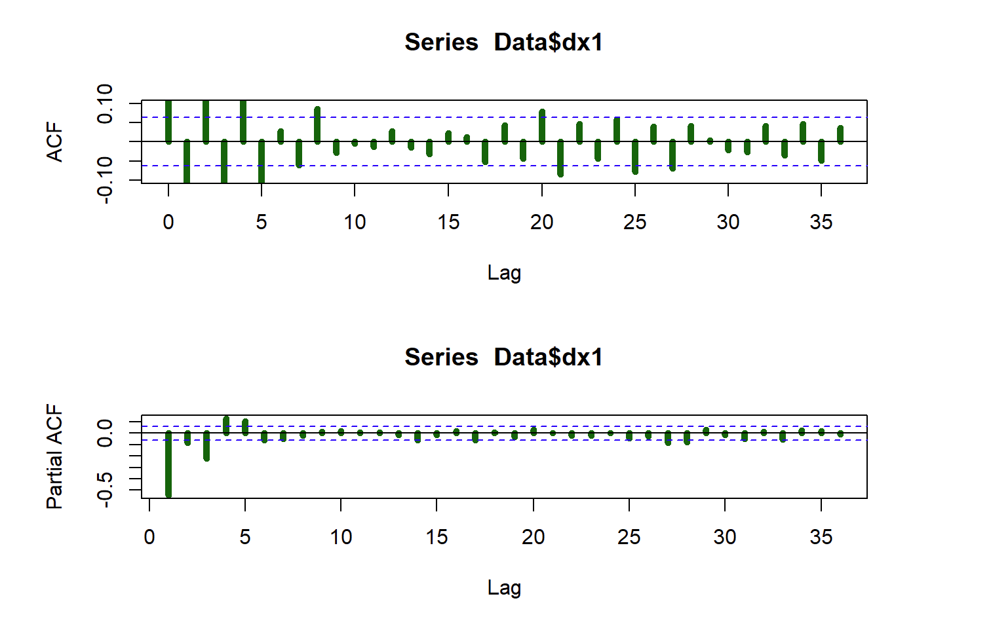
Time series X1: Initial Identification of Parameters p and q
The PACF suggests an AR(5) or AR(7).
Initial candidate is ARIMA(5,1,0).
Variations: ARIMA(5,1,1), ARIMA(4,1,0), ARIMA(3,1,0), ARIMA(7,1,0).

Slide 10
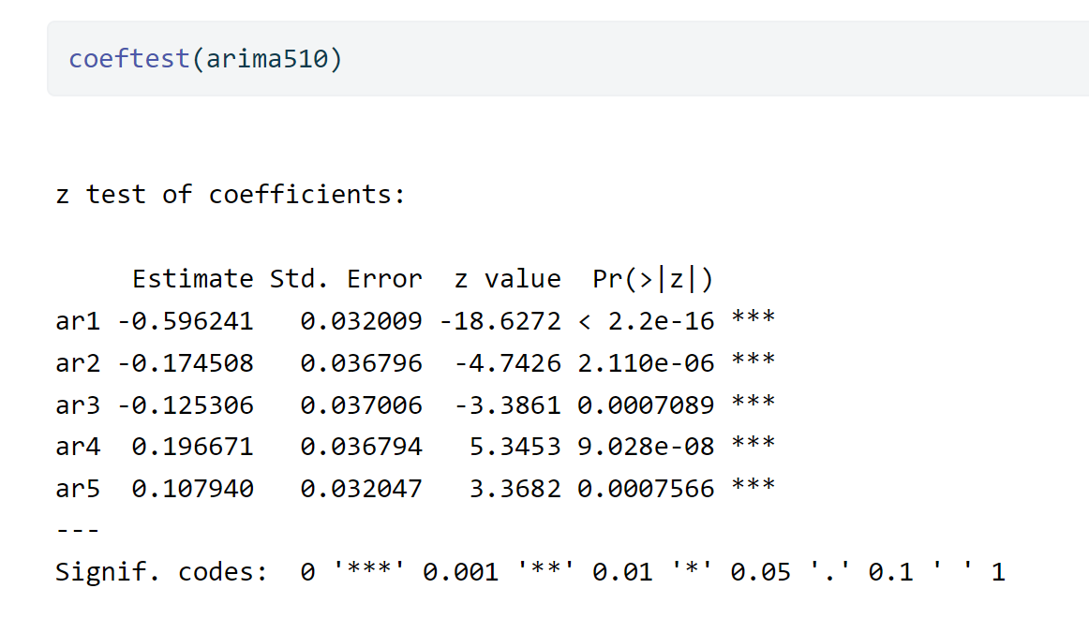
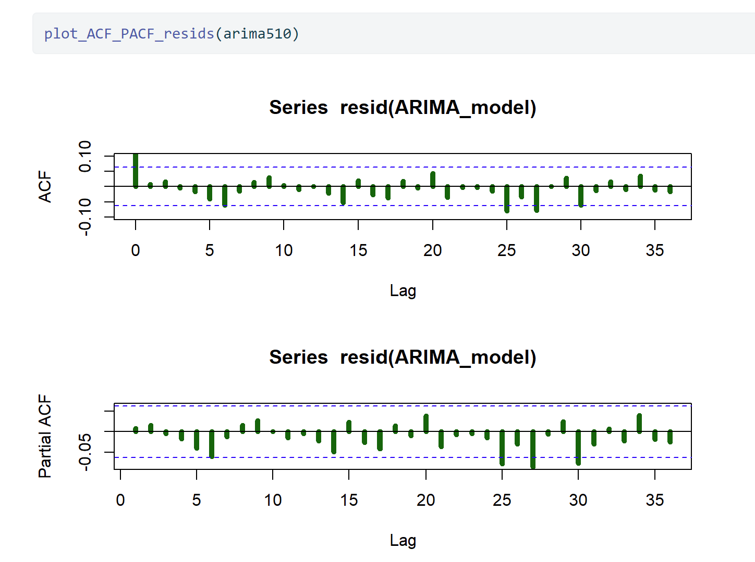
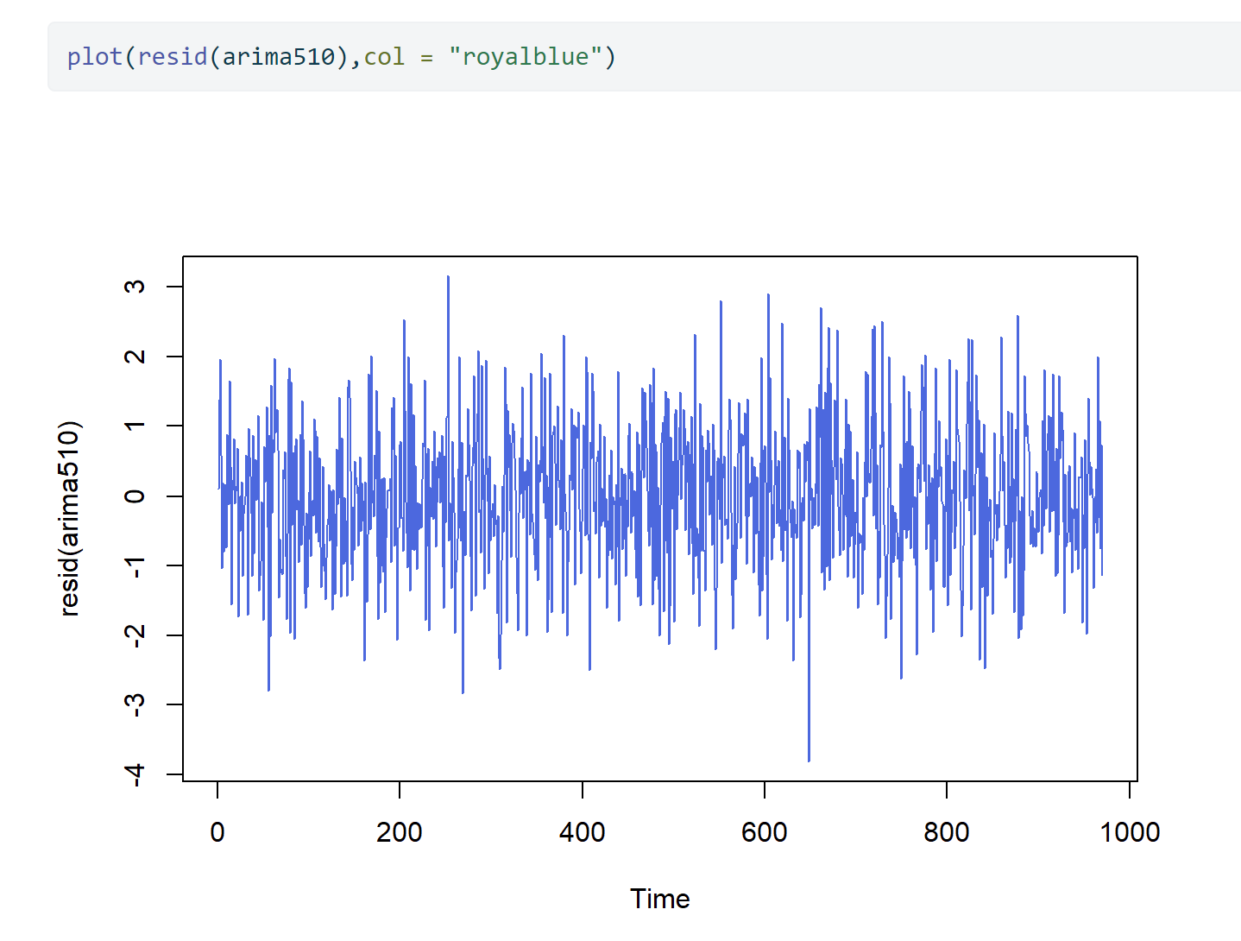
TS X1: Model Summary & Residuals Test for Auto-correlation
Ljung-Box for Resid. | P-value
lag = 10 | 0.7214
lag = 15 | 0.7733
lag = 20 | 0.7768
lag = 25 | 0.5961

Slide 11
Comparing Models for X1
 | Sig. Of Coeff | residuals | AIC | BIC
arima510 | All terms | white-noise | 3rd | 1st
arima511 | All terms; except MA1 | white-noise | 4th | 5th
arima410 | All terms | white-noise | 5th | 3rd
arima310 | All terms | auto-correlation | 6th | 4th
arima313 | All terms, except MA1, MA3. | White noise | 1st | 2nd
arima710 | All terms, except AR5, AR7 | white-noise | 2nd | 6th
Conclusion: We use ARIMA(3,1,3) for forecasting Time Series X1.

Slide 12
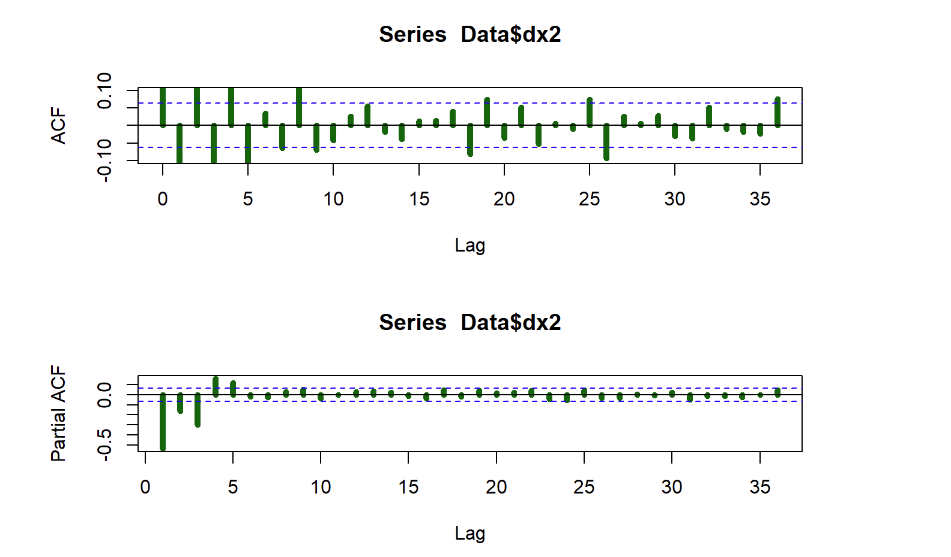
TS X2: Initial Identification of Parameters p and q
The PACF suggests an AR(5)
Initial candidate is ARIMA(5,1,0).
Variations: ARIMA(5,1,1), ARIMA(4,1,0), ARIMA(3,1,0).

Slide 13
Comparing Models for X2
 | Sig. Of Coeff | residuals | AIC | BIC
arima510 | All terms | white-noise | 2nd | 1st
arima511 | All terms, except MA1 | white-noise | 3th | 3rd
arima410 | All terms | white-noise except lag20 | 4th | 4th
arima310 | All terms | auto-correlation | 5th | 5th
arima313 | All terms, except MA3. | white noise | 1st | 2nd
Conclusion: We use ARIMA(5,1,0) for forecasting Time Series X2.

Slide 14
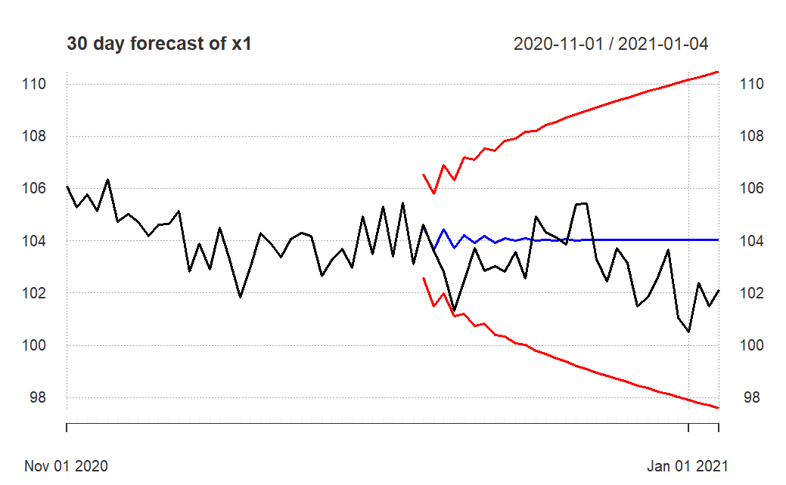
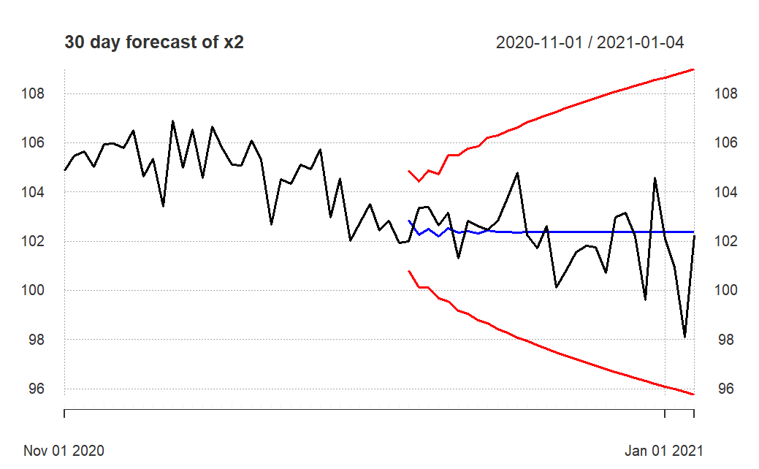


Forecasting for TS X1 and X2

Slide 15
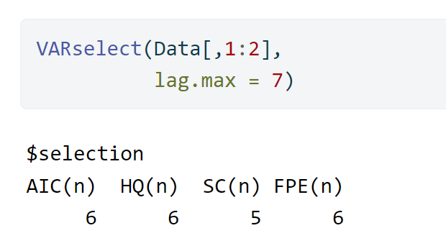
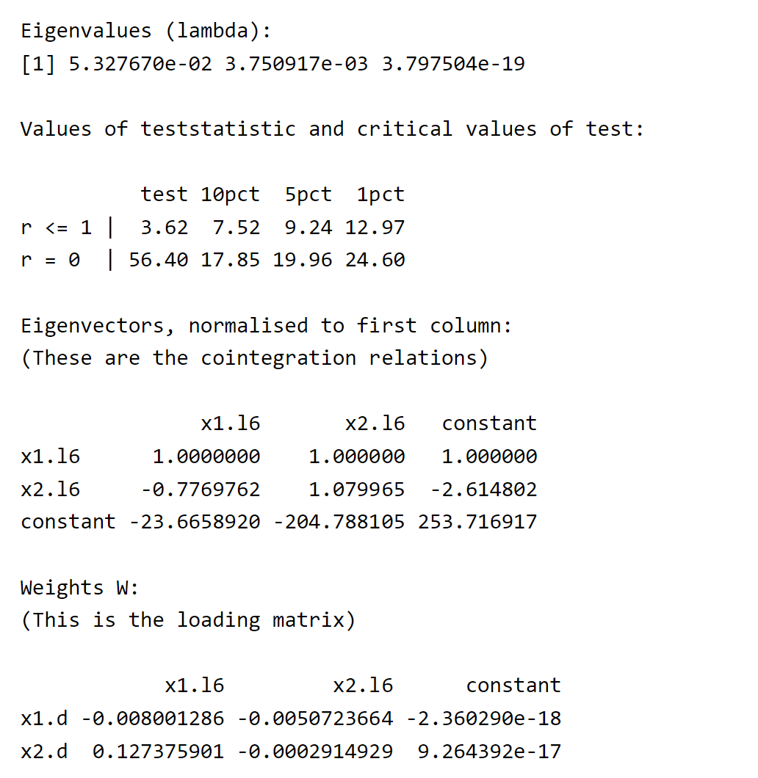
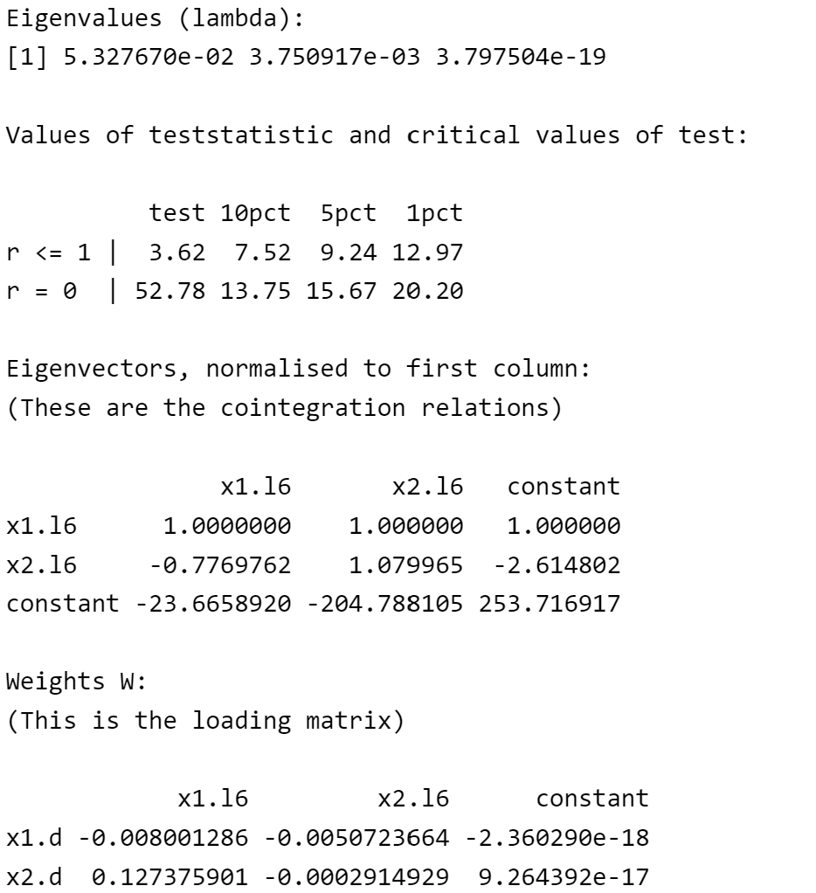
III. VECM Model and Analysis
Johansen Cointegration Test
Determine the lag
Method 1: Trace
Method 2: Eigen
The model has ONLY 1 cointegrating vector.

Slide 16
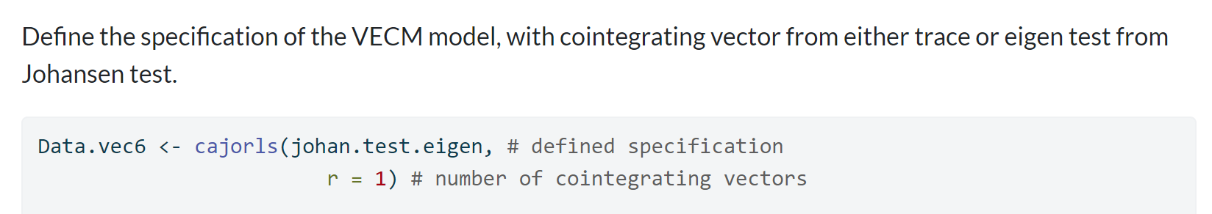
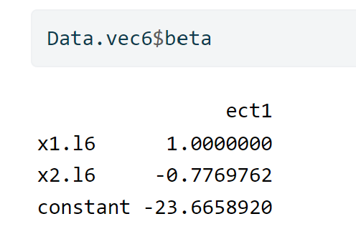
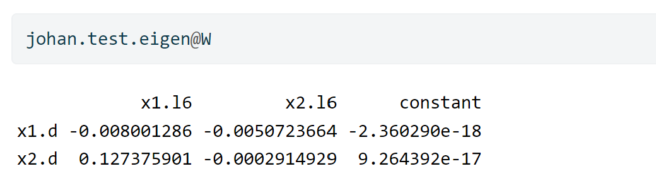
VECM Model
Cointegrating Vector
Adjustment Coefficients
Adjustment Coeff has different sign -> ECM works.
Reparametrizing VEC model into VAR:
Notes:
Delta X1 = -0.008001286 * (x1 - 0.7769762 *x2 - 23.6658920) + …...​
Delta X2 = 0.127376 * (x1 - 0.7769762 *x2 - 23.6658920) + …..

Slide 17
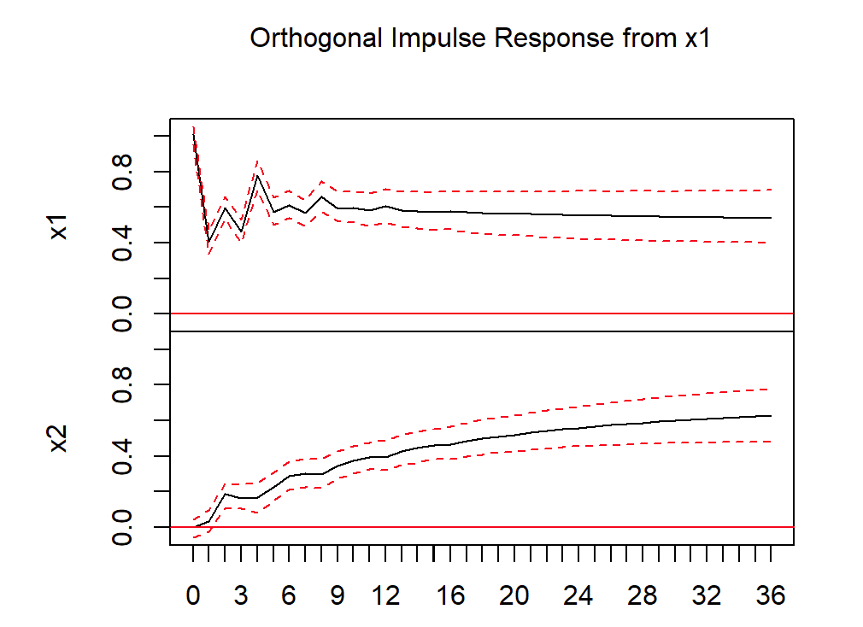
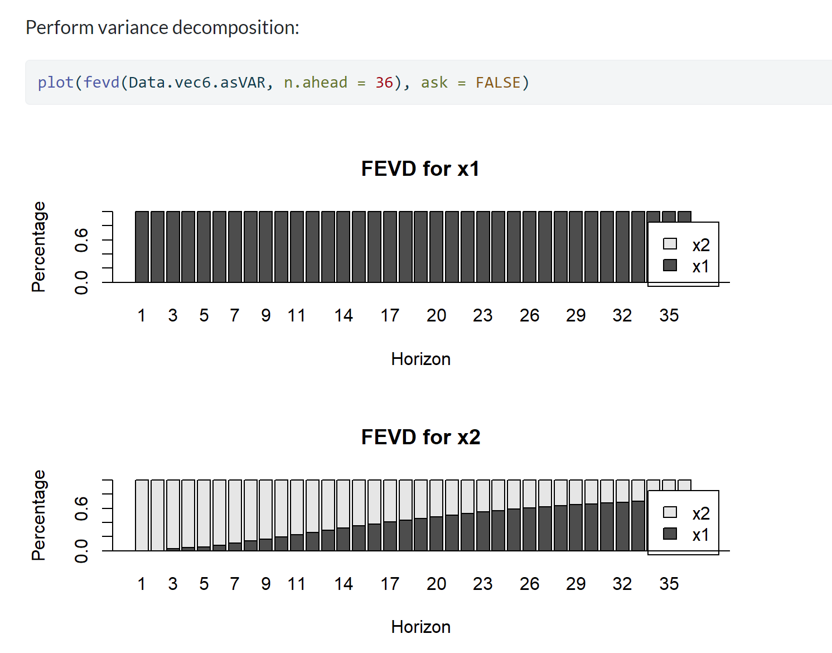
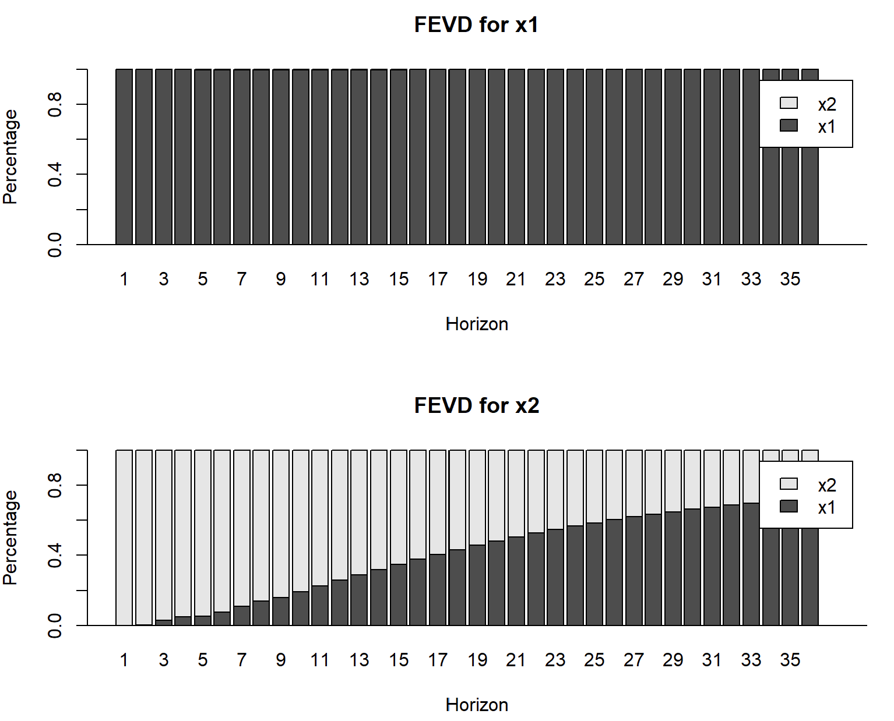
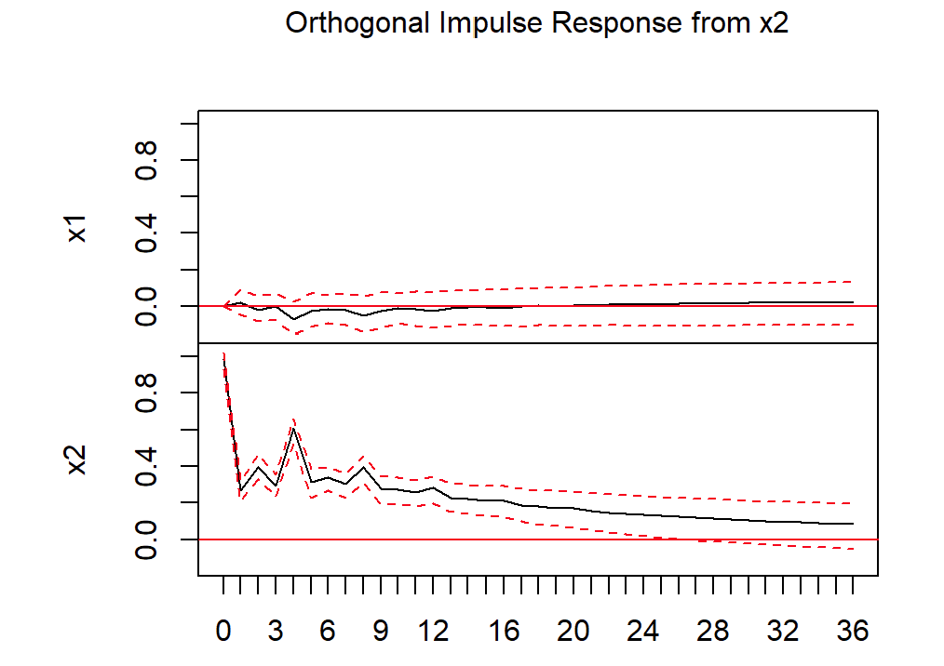
Impulse Response Functions & Variance Decomposition
The residuals seem to be stable.

Slide 18
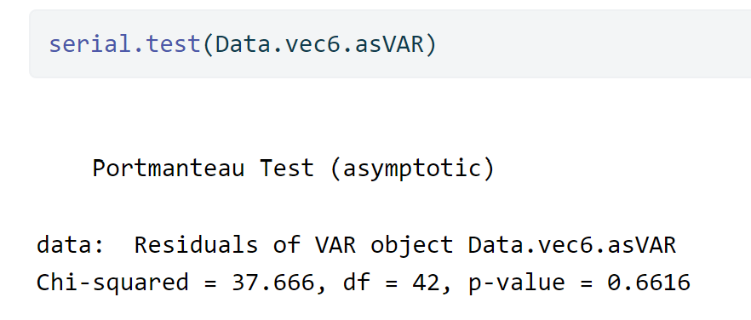
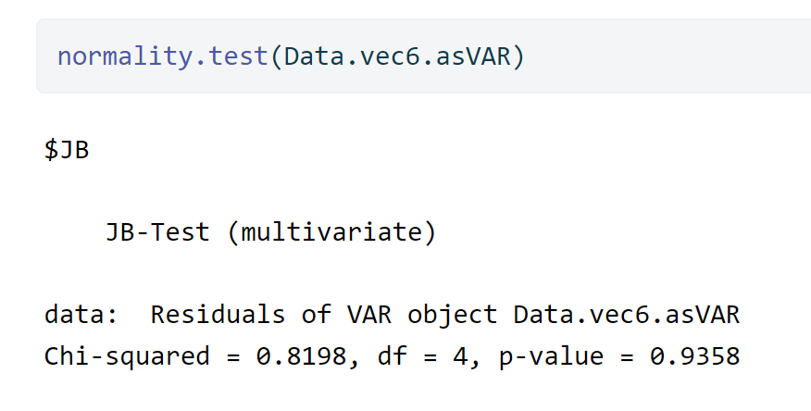
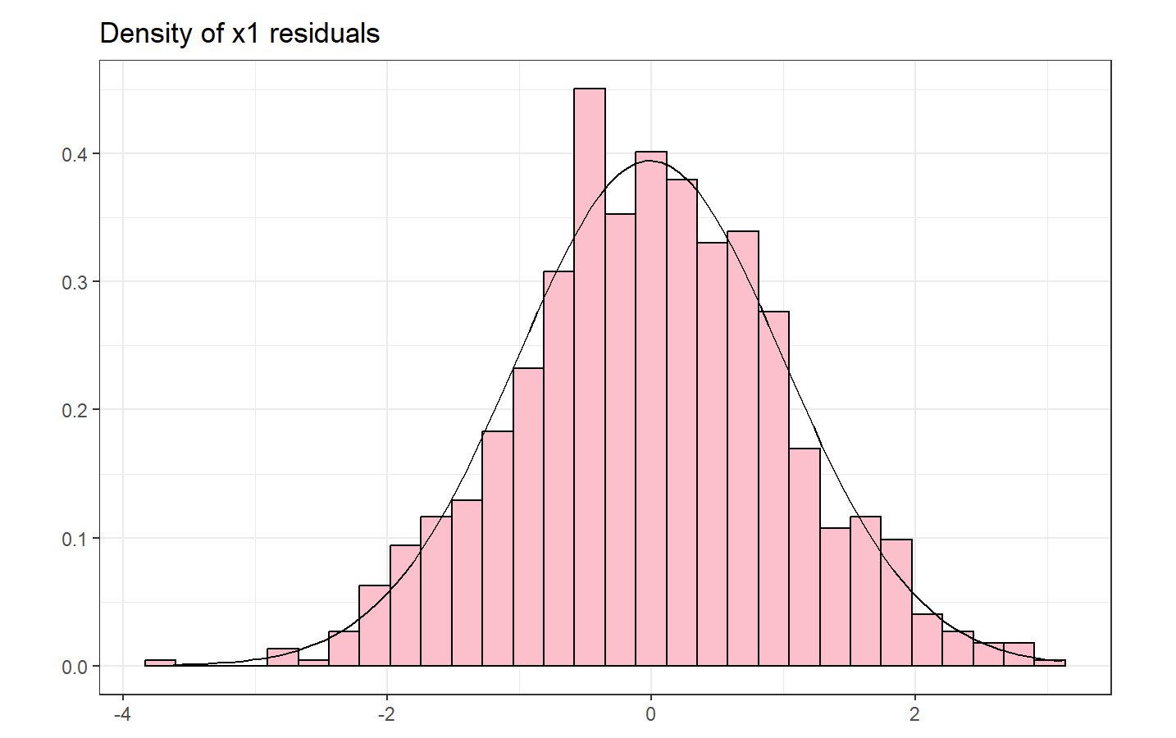
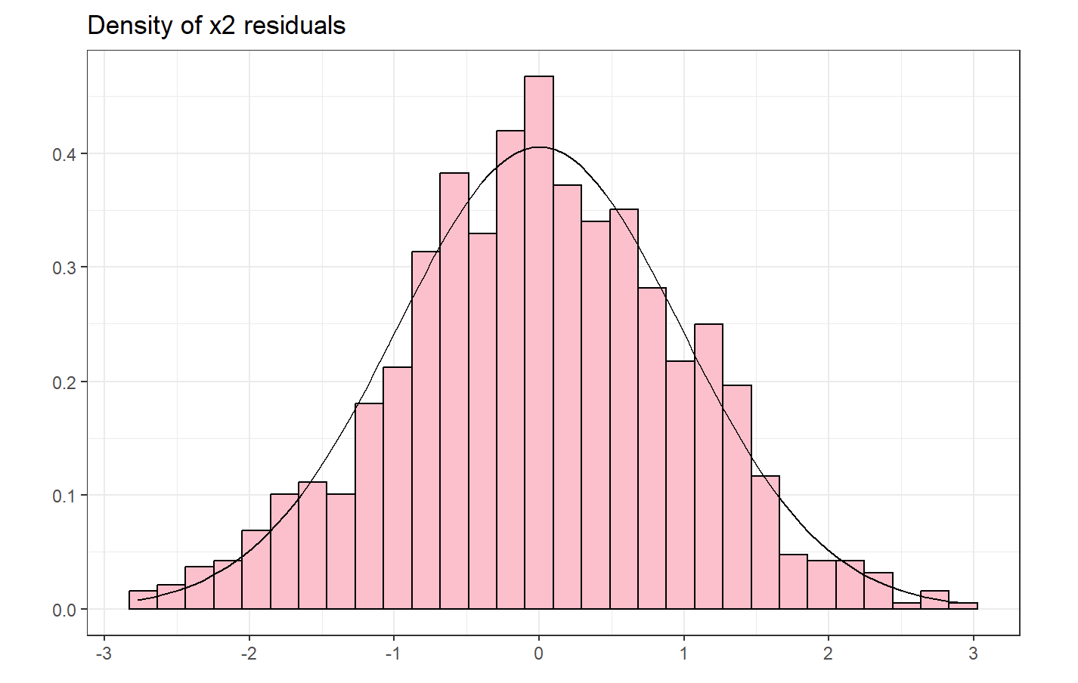
Checking Residual's Normalization
Residuals: No auto-correlation & Normal Distribution.
Notes:
The Ljung-Box Q-test is a "portmanteau" test that assesses the null hypothesis that a series of residuals exhibits no autocorrelation for a fixed number of lags L

Slide 19
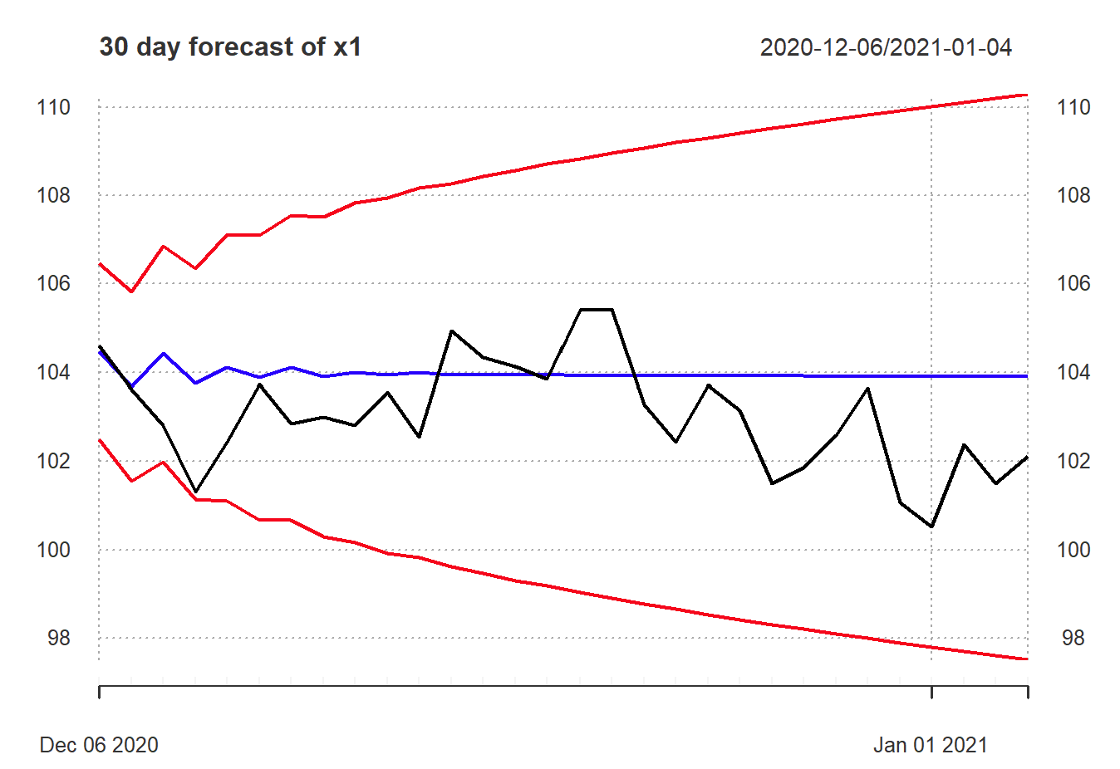
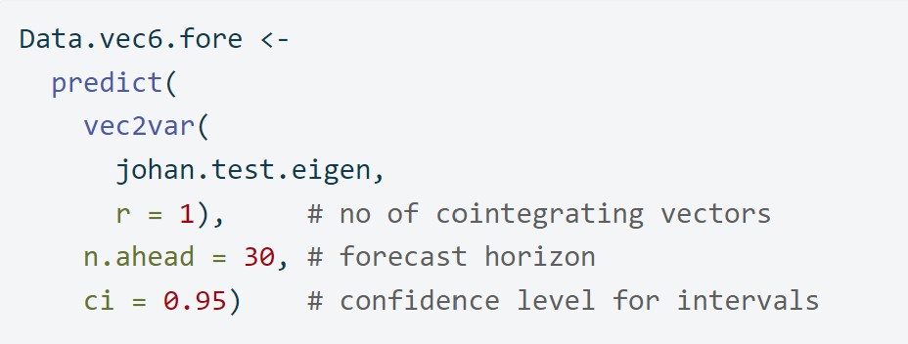
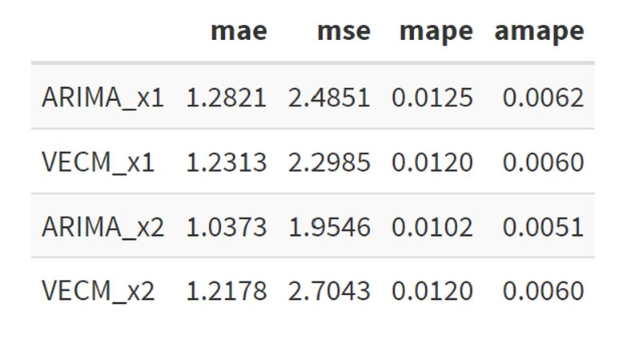
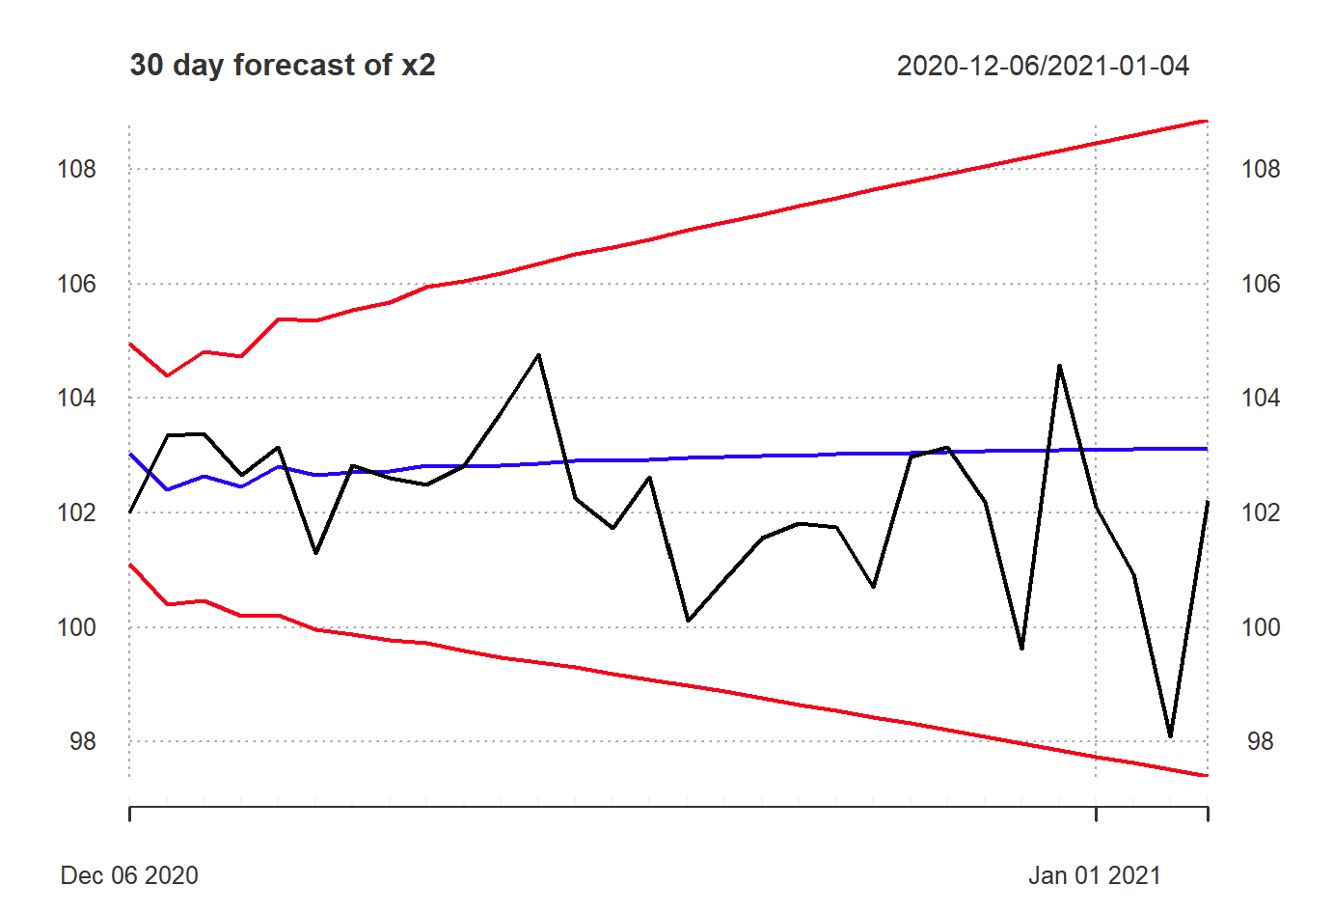
Forecast and Comparing Models
X1: Forecasts of VECM Model outperform
X2: Forecasts of ARIMA Model outperform

Slide 20

Thank you for your attention!! (not on the memes)

Slide 21



Applying Box-Jenkins Procedure

Slide 22
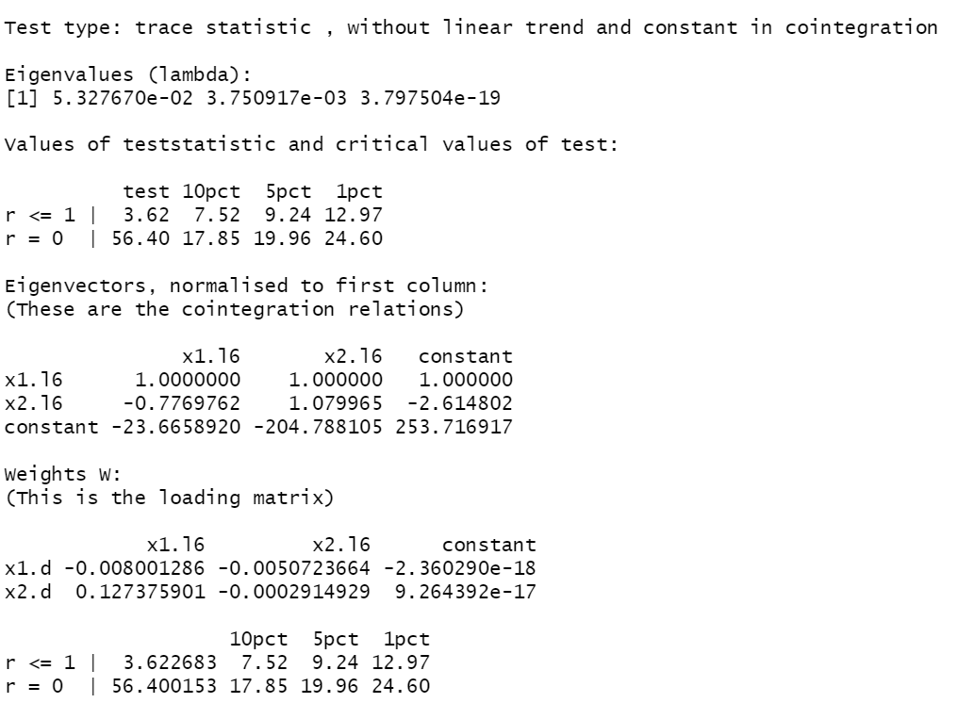

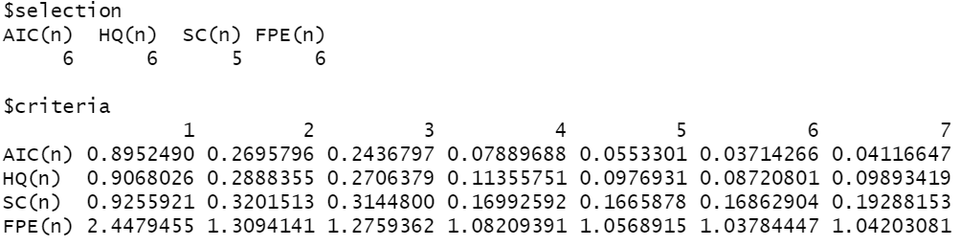


Johansen Cointegration Test
Determining the lag
Check for another type of test: for Eigen
Same Conclusion

